Slide 1
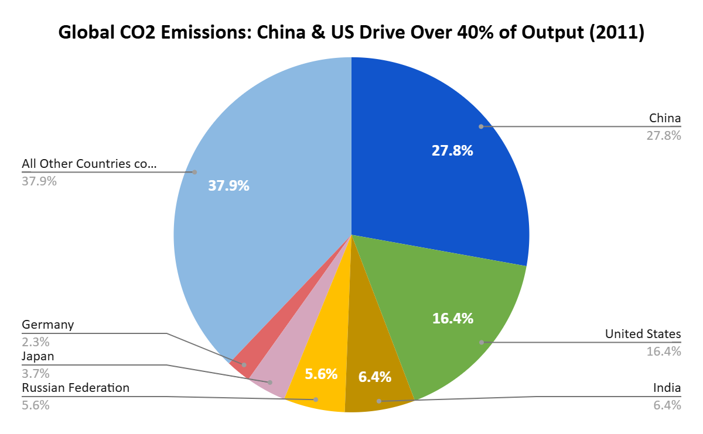
Global Carbon Dioxide (CO₂) Emissions Dashboard

Slide 2
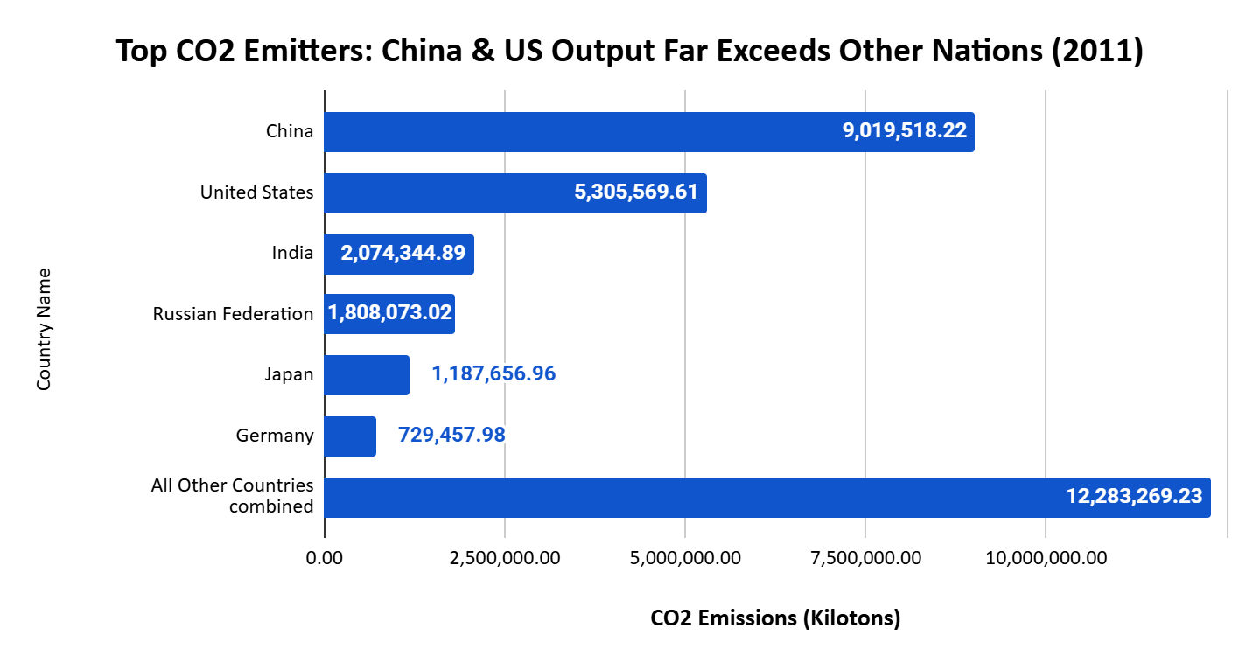

Slide 3
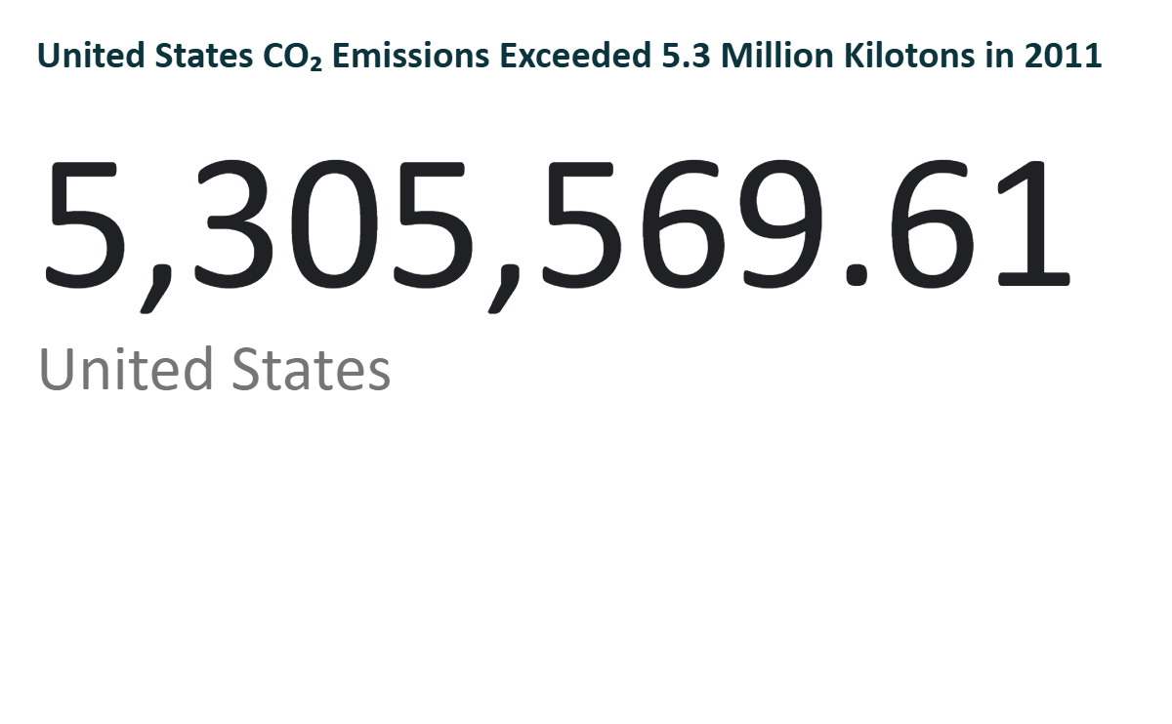

Slide 4
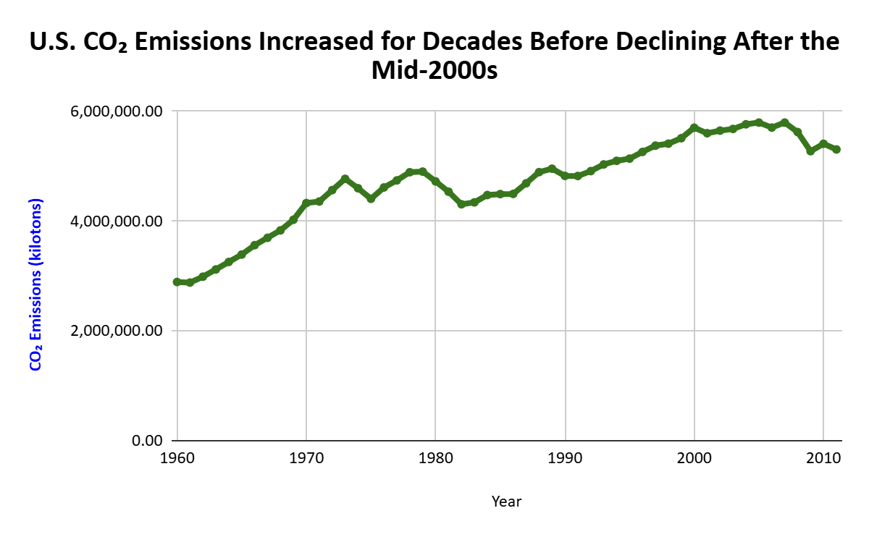

Slide 5

Global Carbon Dioxide (CO₂) Emissions Dashboard

